Slide 1


Slide 2
Event-based Vision meets Deep Learning on Steering Prediction for Self-driving Cars
Abdur Rahman Mohammed
MS Electrical Engineering, ECE Department
Advisor(s) : Cong wang , Monteria Bass
Committee Members : Tao Han
Date : 03/01/2023

Slide 3
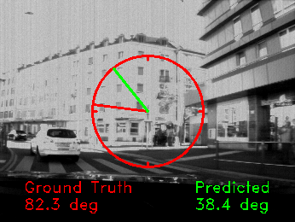
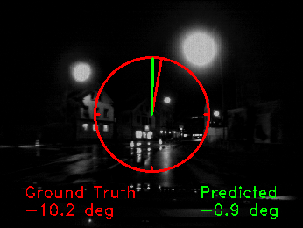
Problem Statement
“Steering angle” is very
Important parameter when it
Comes to self-driving cars,
If its not predicted accurately then it could lead to accidents and collision which certainly is not a suitable outcome
Figure: Steering angle regression performance on grayscale frames, The first image shows a sunny day where visual features can be extracted from grayscale frames. However the camera saturation and the lack of temporal information makes the network predict a wrong steering angle and the second image shows a night scene, from which the network hardly predicts the correct steering angle when using grayscale frames.
Basically if the predicted steering angle goes wrong even by minute difference there potentially could be collisions and accidents.

Slide 4
Significance of the problem and its impact
Self-driving cars need the correct and accurate techniques to efficiently predict steering angle when in motion otherwise it could lead to failure and potential mishaps.
Developing robust policies for autonomous driving is challenging research problem and developing a robust and efficient method for predicting accurate steering angle becomes a priority
If there is an approach which can be used to predict steering angles, especially under conditions where grayscale frames fail, e.g., large input spaces, challenging illumination conditions, and fast motion then it could significantly reduce the collisions and accidents and if this problem is addressed then solving all tasks related to motion estimation will be smooth and efficient

Slide 5
Prior Work
Highly engineered, modular systems demonstrated incredible performance in both urban and off-road scenarios.
Another approach to the problem is to directly map visual observations to control actions, tightly coupling the perception and control parts of the problem.
The first attempt to learn a visuomotor policy was done with ALVINN (Autonomous land vehicle in a neural network), where a shallow network was used to predict actions directly from images. Even though it only succeeded in simple scenarios, it suggested the potential of neural networks for autonomous navigation.
More recently, NVIDIA used a CNN to learn a driving policy from video frames. In spite of being a very simple approach, the learned controls were able to drive a car in basic scenarios.

Slide 6
Prior Art contd.
All previous methods operate on images acquired by traditional frame-based camera.
As opposed to the classification approximation of all previous methods, this paper addresses a continuous estimation problem (steering angle prediction) from a regression point of view.
Hence, we are the first to tackle continuous estimation problems with event cameras in a principled way without resorting to partitioning the solution space.
Moreover, in contrast to previous event-based vision learning works which use small datasets, we show results on the largest and most challenging (due to scene variability) event-based dataset to date

Slide 7
Objectives
This paper presents a deep neural network approach that unlocks the potential of event cameras on a challenging motion-estimation task: prediction of a vehicle’s steering angle.
To make the best out of this sensor–algorithm combination, we adapt state-of-the-art convolutional architectures to the output of event sensors and extensively evaluate the performance of our approach on a publicly available large scale event-camera dataset (≈1000 km).

Slide 8
Objectives contd.
Event cameras, such as the Dynamic Vision Sensor (DVS) are bio-inspired sensors that, in contrast to traditional cameras, do not acquire full images at a fixed framerate but rather have independent pixels that output only intensity changes (called “events”) asynchronously at the time they occur.
Hence, the output of an event camera is not a sequence of images but a stream of asynchronous events.
Event cameras have multiple advantages over traditional cameras: very high temporal resolution (microseconds), very high dynamic range (HDR) (140 dB) and low power and bandwidth requirements.
Moreover, since events are generated by moving edges in the scene, event cameras are natural motion detectors and automatically filter out any temporally-redundant information.

Slide 9
Objectives contd.
We present qualitative and quantitative explanations of why event cameras allow robust steering prediction even in cases where traditional cameras fail, e.g., challenging illumination conditions and fast motion.
Finally, we demonstrate the advantages of leveraging transfer learning from traditional to event-based vision and show that our approach outperforms state-of-the-art algorithms based on standard cameras.
Our approach aims at predicting steering wheel commands from a forward-looking DVS sensor mounted on a car.

Slide 10
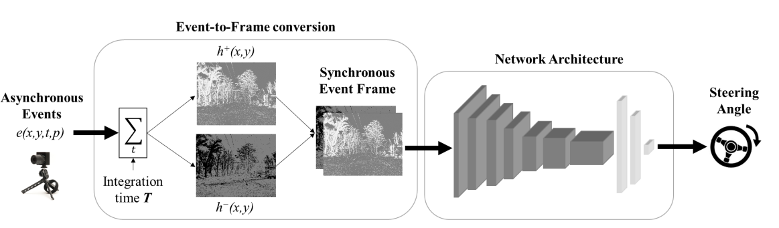
As shown in Figure above we propose a learning approach that takes as input the visual information acquired by an event camera and outputs the vehicle’s steering angle. The events are converted into event frames by pixel-wise accumulation over a constant time interval. Then, a deep neural network maps the event frames to steering angles by solving a regression task
Research Methodology and Approach

Slide 11
Research Methodology and Approach contd..
Event-to-Frame Conversion :- All recent and successful deep learning algorithms are designed for traditional video input data (i.e., frame-based and synchronous) to benefit from conventional processors. In order to take advantage of such techniques, asynchronous events need to be converted into synchronous frames. To do that, we accumulate the events1 ek = (xk , yk ,tk , pk) over a given time interval T in a pixel-wise manner, obtaining 2D histograms of events.
Since event cameras naturally respond to moving edges, these histograms of events are maps encoding the relative motion between the event camera and the scene. Additionally, due to the sensing principle of event cameras, they are free from redundancy

Slide 12

Research Methodology and Approach contd..
The histogram for positive events is
where δ is the Kronecker delta, and the histogram h − for the negative events is defined similarly, using pk = −1. The histograms h+ and h− are stacked to produce a two-channel event image. Events of different polarity are stored in different channels, as opposed to a single channel with the balance of polarities (h+ − h−), to avoid information loss due to cancellation in case events of opposite polarity occur in the same pixel during the integration interval T.

Slide 13
Research Methodology and Approach contd..
Learning Approach :-
Preprocessing: A correct normalization of input and output data is essential for reliably training any neural network. Since roads are almost always straight, the steering angle’s distribution of a driving car is mainly picked in [−5◦ ,5 ◦ ]. This unbalanced distribution results in a biased regression.
In addition, vehicles frequently stand still because they are exposed, for example, to traffic lights and pedestrians. In those situations where there is no motion, only noisy events will be produced.

Slide 14
Research Methodology and Approach contd..
To handle those problems, we pre-processed the output variable (i.e. steering angles) to allow successful learning. To cope with the first issue, only 30 % of the data corresponding to a steering angle lower than 5◦ is deployed at training time.
For the latter we filtered out data corresponding to a vehicle’s speed smaller than 20km h−1. To remove outliers, the filtered steering angles are then trimmed at three times their standard deviation and normalized to the range [−1,1].
At testing time, all data corresponding to a steering angle lower than 5◦ is considered, as well as scenarios under 20km h−1. The regressed steering angles are denormalized to output values in the range [−180◦ ,180◦ ]. Finally, we scaled the network input (i.e., event images) to the range [0,1].

Slide 15
Research Methodology and Approach contd..
Network architecture: To unlock the power of convolutional architectures for our study case, we first have to adapt them to accommodate the output of the event camera. Initially, we stack event frames of different polarity, creating a 2D event image. Afterwards, we deploy a series of ResNet architectures, i.e., ResNet18 and ResNet50, since they have proved to be easier to optimize as the number of layers (depth) increases, and to better cope with overfitting. As these networks have been designed for image classification purposes, we use them as feature extractors for our regression problem, considering only their convolutional layers

Slide 16
Research Methodology and Approach contd..
To encode the image features extracted from the last convolutional layer into a vectorized descriptor, we use a global average pooling layer [23] that returns the features’ channel-wise mean.
This choice has proved to improve the performance, compared to directly adding a fully connected layer, since it minimizes overfitting by reducing the total number of parameters and it better propagates the gradients. After the global average pooling, we add a fully-connected (FC) layer (256-dimensional for ResNet18 and 1024-dimensional for ResNet50), followed by a ReLU non-linearity and the final one-dimensional fully-connected layer to output the predicted steering angle.

Slide 17
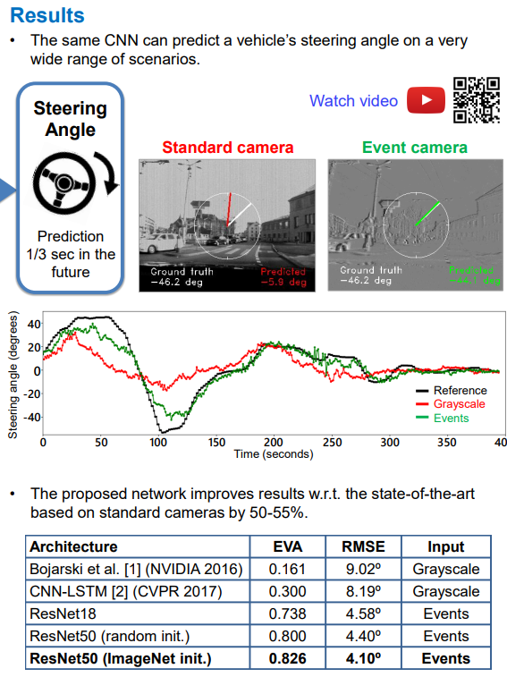
Major Findings and Results

Slide 18
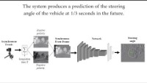
Major Findings and Results

Slide 19
Conclusions
In this work, we showed how a DL-based approach can benefit from the natural response of event cameras to motion and accurately predict a car steering angle under a wide range of conditions.
Our DL approach, specifically designed to work with the output of event sensors, learns to predict steering angles by picking them up from the motion cues contained in event-frames. Experimental results showed the robustness of the proposed method, especially under those conditions where grayscale frames fail, e.g., large input spaces, challenging illumination conditions, and fast motion.
In conclusion, we showed that it outperforms other state-of-the-art systems based on traditional cameras

Slide 20
Future Research
Interesting future work concerning this problem is to use reinforcement learning techniques to produce an adaptive integration time policy that depends on the car’s speed and the observed scene.
State-of-the-art convolutional networks need lots of data to pick up on important motion features. To simplify the task, we showed that it is possible to transfer knowledge from networks trained with traditional images on classification tasks. As a result, we were able to unlock the capabilities of event cameras to solve the task at hand.

Slide 21
Acknowledgements and References
This project was funded by the Swiss National Center of Competence Research (NCCR) Robotics, through the Swiss National Science Foundation, and the SNSF-ERC starting grant. This work has also been partially supported by the Ministerio de Econom´ıa, Industria y Competitividad (AEI/FEDER) of the Spanish Government under project TEC2016-75981 (IVME).
The Titan Xp used for this research was donated by the NVIDIA Corporation.

Slide 22
Questions?
Thank the committee for their attention and ask if there are any questions.

Slide 23
L3 -Net: Towards Learning based LiDAR Localization for Autonomous Driving
Abdur Rahman Mohammed
MS Electrical Engineering, ECE Department
Advisors : Cong wang , Monteria Bass
Committee Members : Tao Han
Date : 03/01/2023

Slide 24
Problem Statement
In recent years, autonomous driving has gained substantial interest in both academia and in the industry.
A precise and reliable localization module that estimates the position and orientation of the autonomous vehicle is highly critical.
In an ideal situation, the positioning accuracy has to be specific to the level of centimeters and reach subdegree attitude accuracy universally.

Slide 25
Problem Statement
In the last decade, several methods have been proposed to achieve this goal with the help of 3D light detection and ranging (LiDAR) scanners.
A classic localization pipeline typically involves several steps with certain variations as shown in below figure.

Slide 26
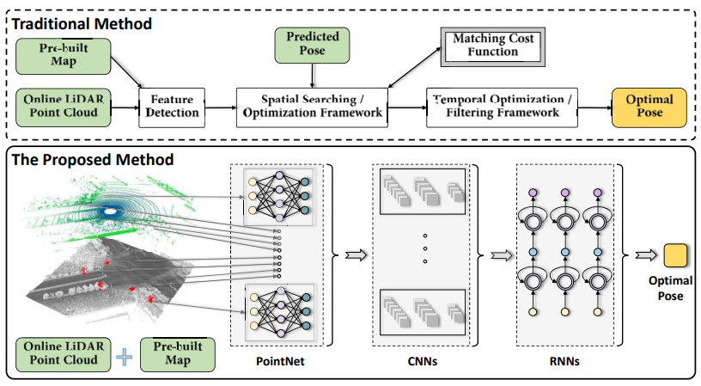
Problem Statement contd.
Architectures of the traditional and the proposed learning based method. In our method, L3-Net takes online LiDAR scans, a pre-built map and a predicted pose as inputs, learns features by PointNet, constructs cost volumes over the solution space, applies CNNs and RNNs to estimate the optimal pose.

Slide 27
Significance of the problem and its impact
The learning based method opens a completely new window to solving the above problems in a data-driven fashion. The good part is that it’s easy to collect a huge amount of training data for a localization task because the ground truth trajectory typically can be obtained automatically or semi-automatically using offline methods. In this way, human labeling efforts can be minimized making it more attractive and more cost-effective.
Thus, localization or other 3D related geometry problems are naturally well suited to be solved using the data-driven techniques. Conversely, learning based methods have shown excellent performance in redundant tasks, such as classification, detection or segmentation.
These examples have demonstrated that deep neural networks are very efficient for understanding semantics. But this has not been the case for tasks related to the 3D geometry, for example, the localization problem

Slide 28
Prior Art
LiDAR-based localization for autonomous vehicles has been under study for quite some time because of its precision and reliability compared to other sensors.
Traditional LiDAR localization methods are based on geometry. They rely heavily on geometric constraints to estimate the motion of the vehicle. The most straightforward method is to apply point-cloud registration algorithms to solve the motion problem. Iterative Closest Point (ICP) G-ICP and Normal Distributions Transform (NDT) are common registration algorithms that can be considered.

Slide 29
Prior Art contd.
However, it is known that these registration methods are very sensitive to the initial guess. They fail in scenes without abundant 3D features, such as highways or other open spaces.
Deep learning is a machine learning technique inspired by the structure and function of the human brain. It has shown excellent performance in semantic tasks, for example, detection, classification or segmentation. However, they typically are not considered as effective approaches to geometric problems as humans are not good at accurate distance measuring without the assistance of tools, either.

Slide 30
Objectives
We present L3-Net - a novel learning-based LiDAR localization system that achieves centimeter-level localization accuracy, comparable to prior state-of-the-art systems with hand-crafted pipelines. Rather than relying on these handcrafted modules, we innovatively implement the use of various deep neural network structures to establish a learningbased approach.
L3-Net learns local descriptors specifically optimized for matching in different real-world driving scenarios. 3D convolutions over a cost volume built in the solution space significantly boosts the localization accuracy. RNNs are demonstrated to be effective in modeling the vehicle’s dynamics, yielding better temporal smoothness and accuracy.

Slide 31
Objectives contd.
We comprehensively validate the effectiveness of our approach using freshly collected datasets. Multiple trials of repetitive data collection over the same road and areas make our dataset ideal for testing localization systems.
The SunnyvaleBigLoop sequences, with a year’s time interval between the collected mapping and testing data, made it quite challenging, but the low localization error of our method in these datasets demonstrates its maturity for real industrial implementation.

Slide 32
Research Methodology and Approach
Keypoint Features :- The first step is extracting local feature descriptors from a set of local patches, which we call keypoints. The selection of keypoints considers several local and global geometry characteristics from different aspects. After the keypoint selection, feature descriptors are extracted using a miniversion of PointNet.
Cost volumes and 3D CNN’s :- The next step is building a network to accurately infer the localization offset (Δx, Δy, Δψ). This is done by constructing a cost volume in the solution space (x, y, ψ), and regularize it with 3D convolutional neural networks (3D CNNs).
First of all, we divide the solution space into discrete spaces in x, y and ψ dimensions, and denote nx, ny, nψ as the size in each dimension.

Slide 33
Research Methodology and Approach
In the following, we denote {f1, ..., fN } as the keypoint descriptors of the online LiDAR point cloud. Therefore, the cost volume is N × nx × ny × nψ. Each cell represents the matching cost between the corresponding keypoint and the 3D map point with the given offset.
Implementation :- Hyperparameters :During the keypoint selection, we choose 128 keypoints within a frame of the LiDAR point cloud. The solution space of the cost volume is set as 11 × 11 × 11, and the steps in x, y and ψ dimensions are 0.25m, 0.25m and 0.5◦, respectively. Therefore, the maximum affordable offset of the predicted pose is about (0.25 × 11−1 2 = 1.25m, 1.25m, 2.5◦) which is sufficient for our application.

Slide 34
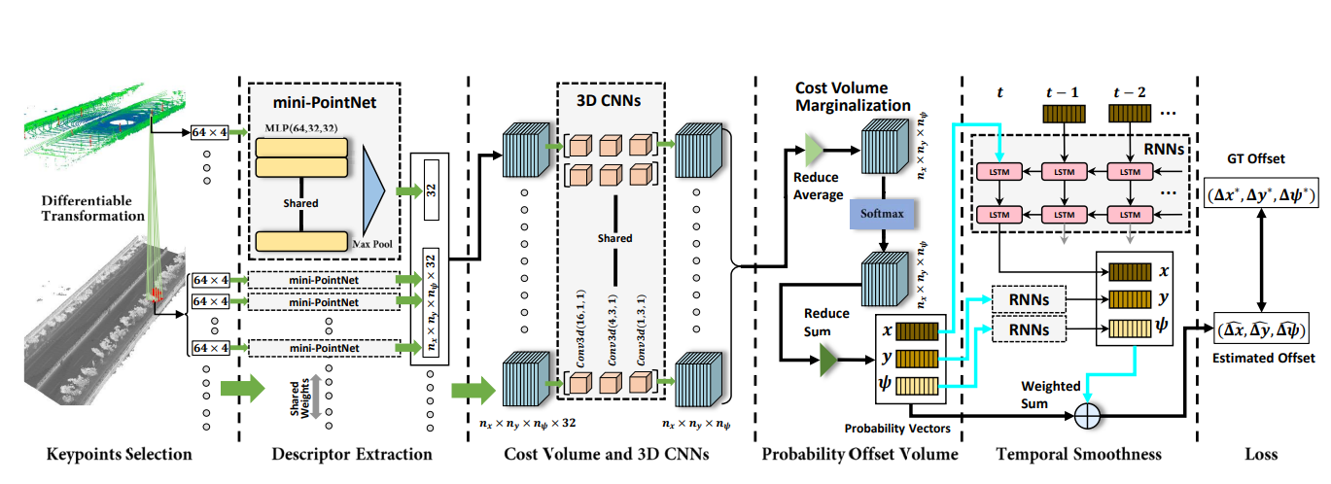
Research Methodology and Approach
Architecture of the proposed Learning-based LiDAR Localization Network, L3-Net. During the first training stage, only the black arrows are involved, which include the keypoint selection, the mini-PointNet feature extraction and the regularization based on the 3D CNNs. The cyan arrows indicate the second training stage where the temporal smoothness based on the RNNs is added

Slide 35
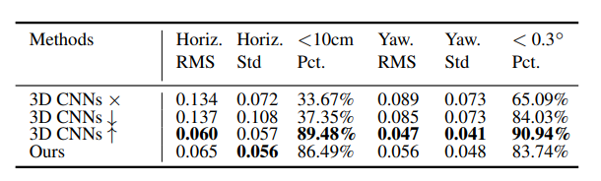
Major Findings and Results
In order to verify the importance of 3D CNNs, we conduct the following experiments: removing 3D CNNs, decreasing layers from 3 to 1 and increasing layers from 3 to 4, denoted as 3D CNNs ×, 3D CNNs ↓ and 3D CNNs ↑. Our results are shown in below table, where the localization accuracy drops heavily using 3D CNNs × and 3D CNNs ↓. This shows that 3D CNNs can learn the real feature distance and effectively regularize the output in the solution space as compared to directly applying the L2 distance between descriptor pairs (No 3D CNNs). Larger capacity 3D CNNs leads to better localization accuracy, however, more data is also required empirically in training. We use 3 layers as a default setup in our method

Slide 36
Conclusions
We have presented a novel learning-based LiDAR localization framework, designed for autonomous driving applications.
Elaborately hand-crafted modules in traditional localization pipelines are substituted with learning-based deep neural networks.
Our system achieves comparable localization accuracy to prior state-of-the-art systems, and is ready for industrial use. The probability offset volume implies the matching confidence over the solution space making it ready to be deployed in a multi-sensor fusion based localization framework.
A 360◦ 3D LiDAR sensor, a high-end integrated navigation system and the data which includes multiple trials of driving over the same road areas in southern San Francisco Bay make our dataset ideal for benchmarking localization systems.

Slide 37
Acknowledgements and References
This work is supported by Baidu Autonomous Driving Business Unit (Baidu ADU) in conjunction with the Apollo Project (http://apollo.auto/).
Weixin Lu∗ Yao Zhou∗ Guowei Wan Shenhua Hou Shiyu Song† Baidu Autonomous Driving Business Unit (ADU) {luweixin, zhouyao, wanguowei, houshenhua, songshiyu}@baidu.com
2019 IEEE/CVF Conference on Computer Vision and Pattern Recognition (CVPR)

Slide 38
Questions?

